Slide 1
cross cultural communication
intercultural considerations

Slide 2
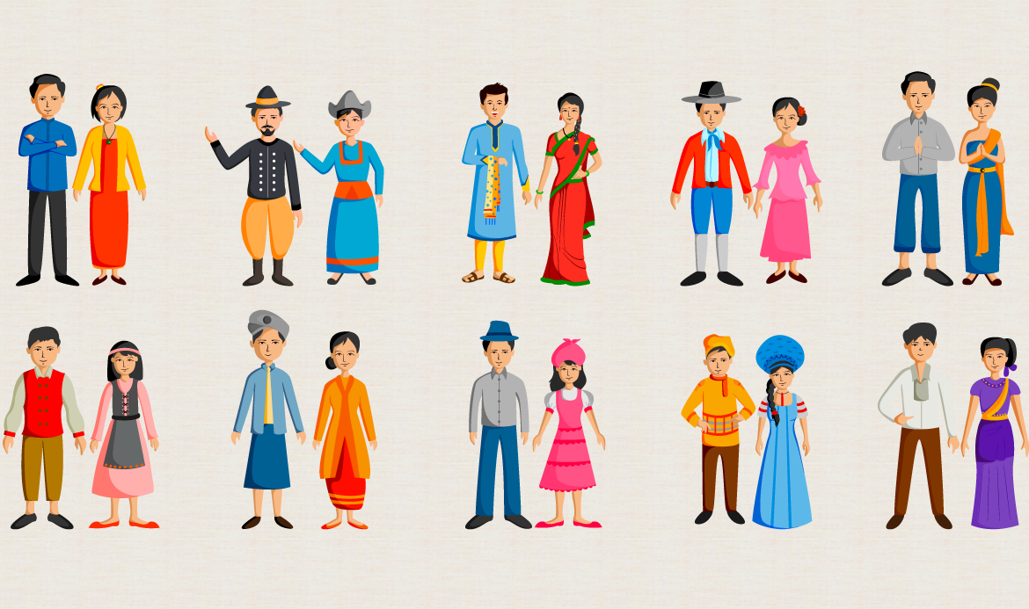

Slide 3


SUPERVISOR​
Eman mohamed
TEAM MEMBERS
Omnia Lashen
Safaa Elsayed
Shimaa Hamdy
Tarek Abdelnaser

Slide 4
Table of Contents
Introduction
Intercultural consideration to take
Stereotyping and avoiding violation of culture values
Handling culture shocks and using slang
Using humor and Gender egalitarianism
Variation of Etiquette and different time Zones

Slide 5
Intercultural communication
Interaction among people from different cultures.
Intercultural communication refers to the effects on communication behavior, when different cultures interact together.

Slide 6
Intercultural consideration

Slide 7
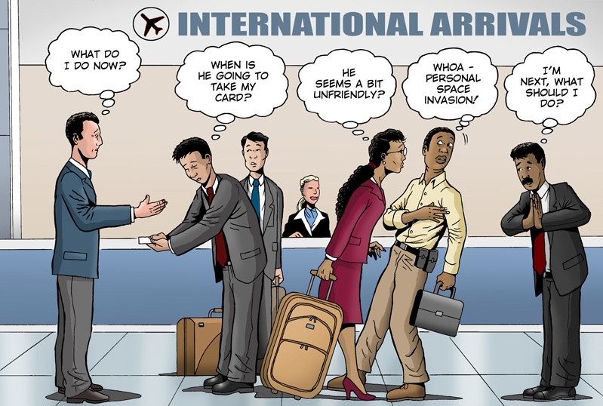

Slide 8
Stereotyping and
global cultures

Slide 9
Stereotyping
Tendency to categorize and make assumptions about others based on identified characteristics such as gender, age, religion, and nationality.

Slide 10
Why stereotyping ?
We stereotype because of our tendency to categorize everything and everyone around us.

Slide 11
Stages of actions that lead to creation of stereotypes
Formation of US” and “THEM” Groups
Preference for the In-group
Illusion of Out-group Homogeneity
Expectancy of confirmation

Slide 12
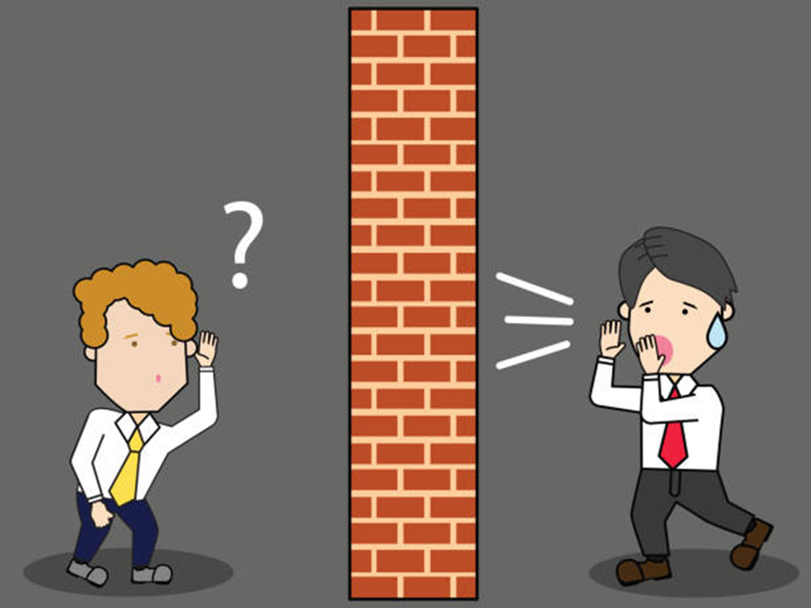
And that leads to:
Barriers to effective multicultural communication….

Slide 13
Cultural values

Slide 14
Cultural values
A series of principles and values passed on generation after generation by our ancestors, decides how a person of that culture will behave and how they will lead their lives.

Slide 15
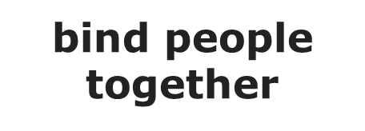
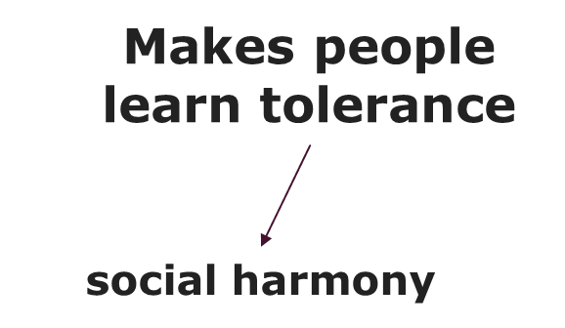

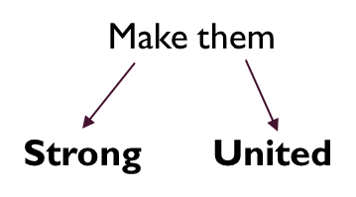
Importance of cultural values

Slide 16
National cultural values differences
Individualism vs. Collectivism
Egalitarianism regarding gender
Humane attitude

Slide 17
Avoiding violation of culture values
Accepting the differences.
Don’t underestimate the values and beliefs of others.

Slide 18
Culture Shock

Slide 19
Culture shock
Culture shock is a feeling of disorientation, annoyance, and/or hostility experienced when you visit a country with norms and traditions different from your own.

Slide 20
culture shock
Culture shock stages
Initial Euphoria (The honeymoon stage)
Irritation and hostility (The negotiation stage)
Gradual understanding (The adjustment stage)
Adaption or biculturalism (The mastery stage)

Slide 21
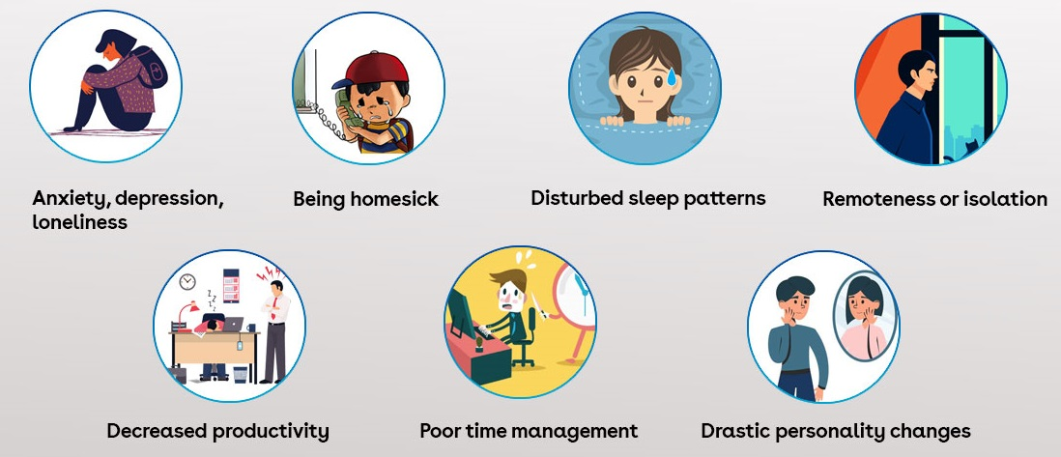
Common symptoms of culture shock

Slide 22
Handling Culture Shock
Learn as much about your host country as possible.
Set learning goals for your trip abroad.
Write down what you love when you first arrive, and look back later.
Get involved with local community.
Make an effort to learn the local language.

Slide 23
Slang

Slide 24
Slang
It is a form of language, which is a linguistic phenomenon ever present and consistently changing, using vocabulary and idioms in informal way that is characteristically more metaphorical, playful, and ephemeral than ordinary language. As ‘salty’, ‘throw shade’,’extra’.

Slide 25
Using slang
Breaks Barriers between one another.
Conveys the traditions and values.
Increases the level of communication and cooperation.
It can be representation of modernity.
Takes away stress associated with formal situations.

Slide 26
Humor

Slide 27
humor
humor is one of the few psychological mechanisms able to instantly transform strangers into people we feel safe around and we can trust.

Slide 28
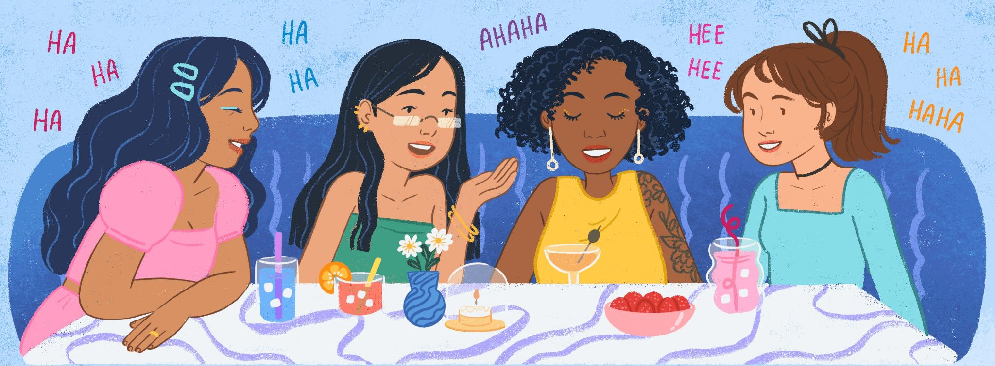



change perception
gain trust
better communicate
it change the way we see people:
assume the person is similar to yourself
(similar opinions, similar thoughts, similar knowledge and simply human like us)

Slide 29
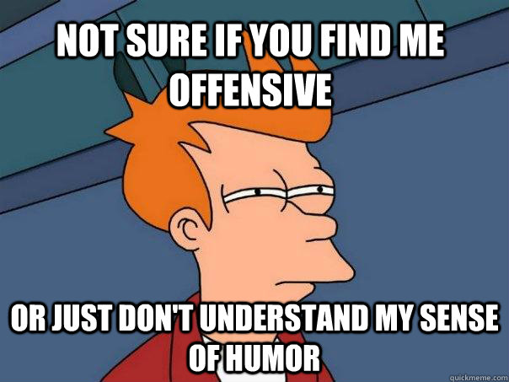
did it just that simple smile to the world it will smile to you:) ?
culture effects on what make a thing funny or not
people in different culture perceive smiling and humor differently

Slide 30
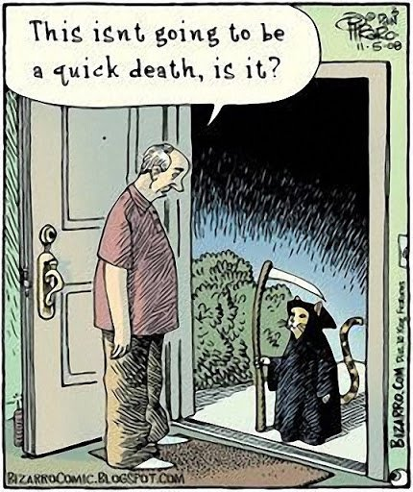
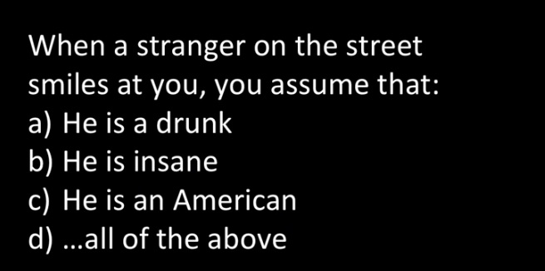
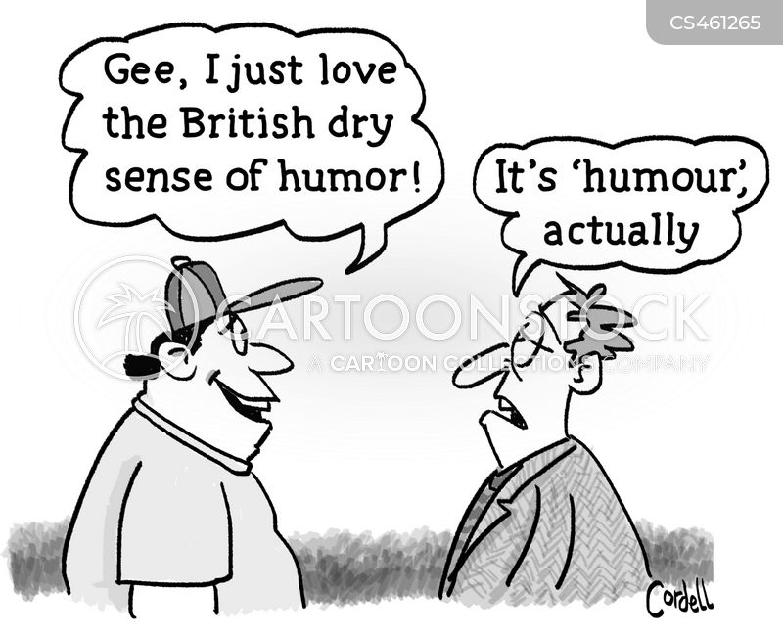
Different cultures perceptions to humor and smiling
Smiling to strangers Poland vs Germany.
British humor (dry, fun in unsuitable situation and self offensive

Slide 31

lack (failed) humor
in cross cultural communication there is a failure with humor sometimes can behavior.
can not understand it → hard to join in
confusion → offensive
can emphasis the difference.
do not draw far-fetched conclusions about yourself and others

Slide 32
Gender egalitarianism

Slide 33
Gender egalitarianism
both women and men have same opportunities and same rights and duties to choose what they want freely.
culture define what woman and men should be do (Gender rules)

Slide 34
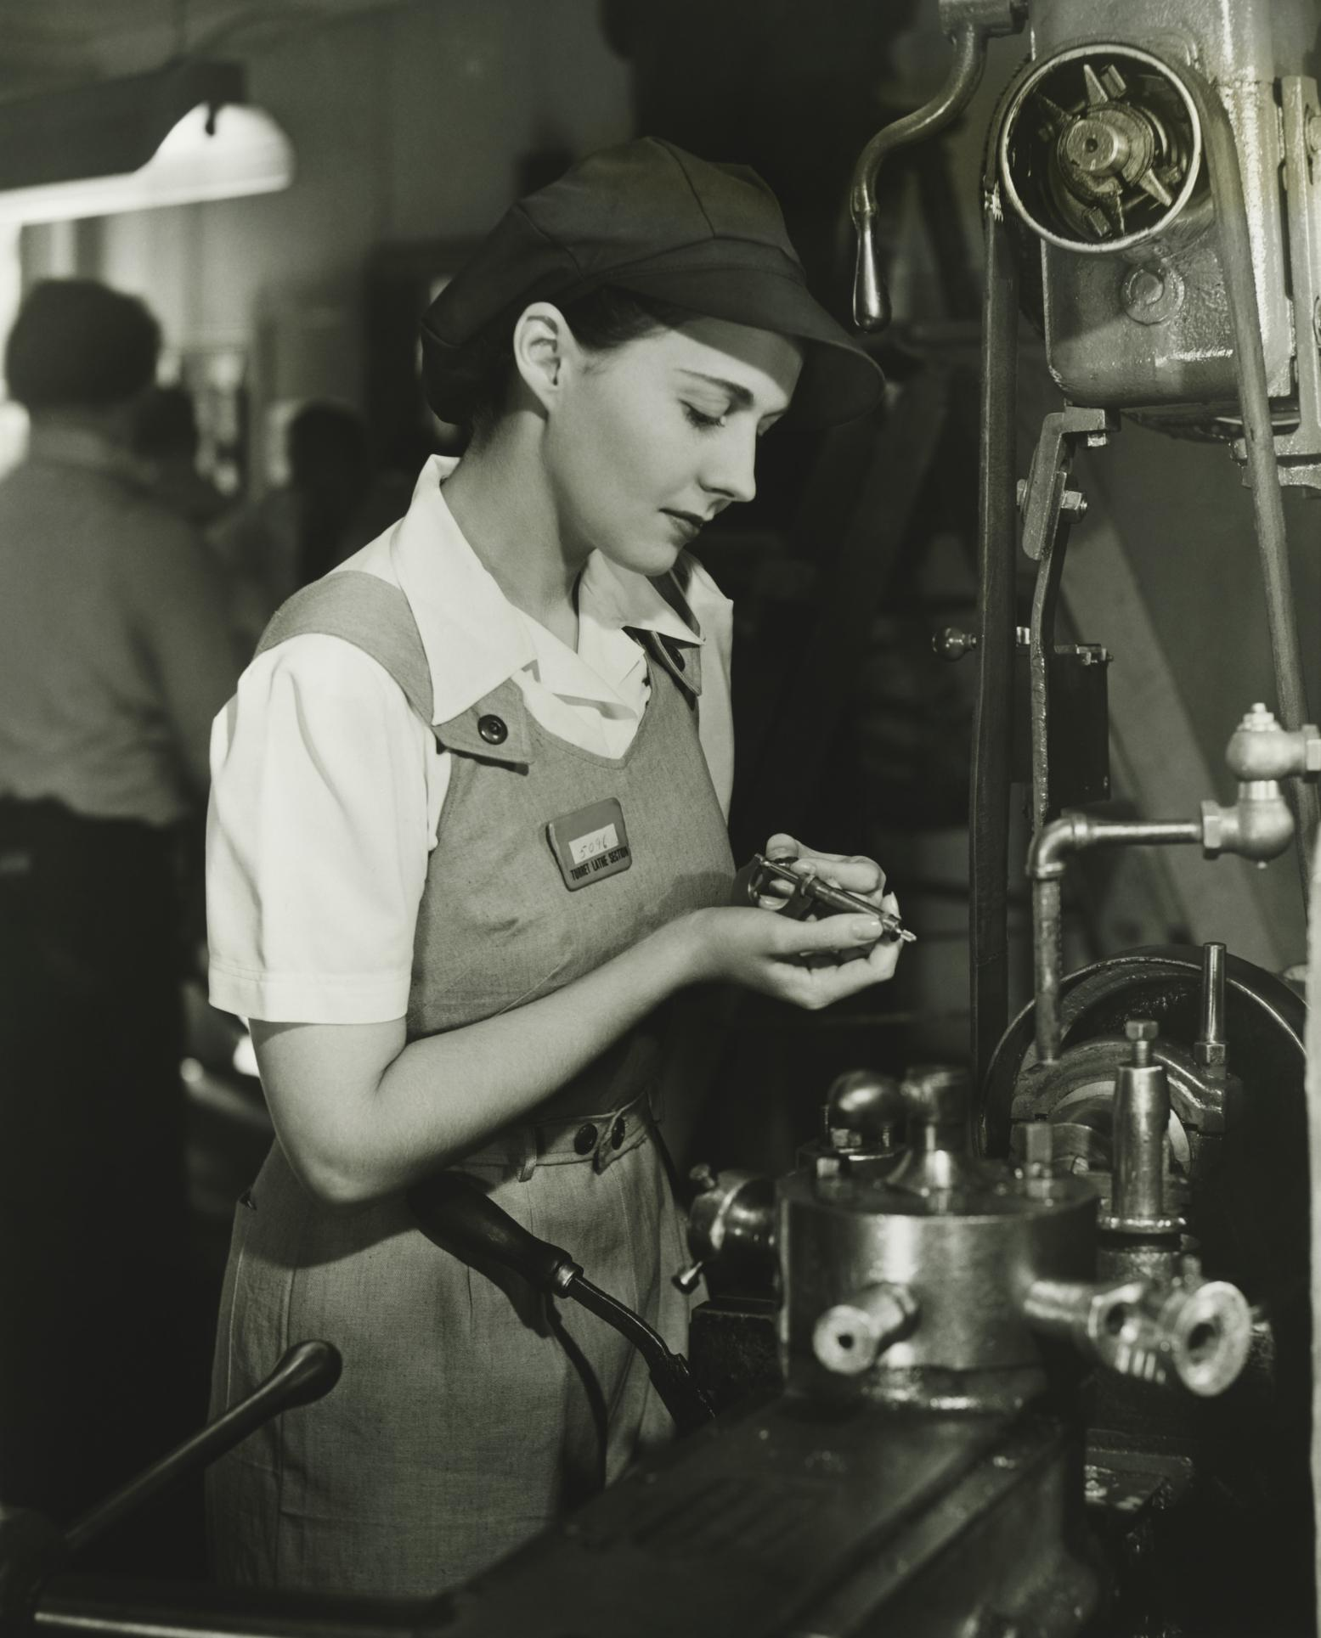
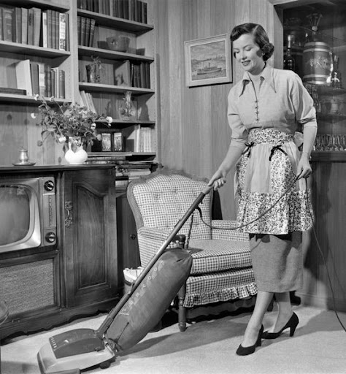
can you guess the decade?

Slide 35
can you guess the decade?
1940s
1950s

Slide 36

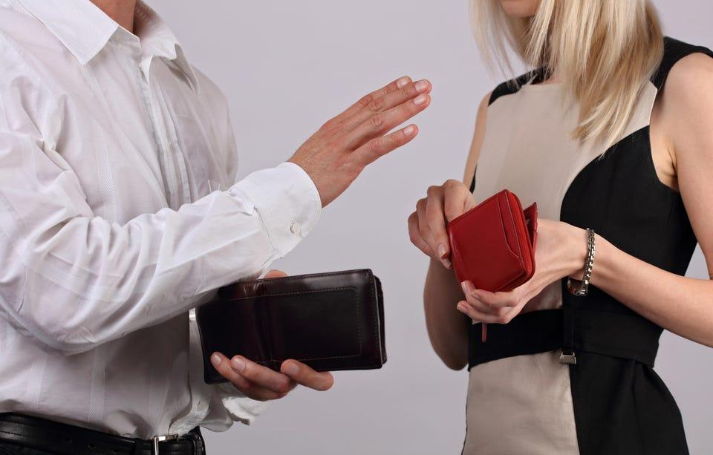

who pay :) ?
some countries it is usual that women pay but in other countries, that behavior consider very offensive.

Slide 37
Variation in etiquette

Slide 38

Variation In Etiquette Between Global Cultures
How do you greet someone you meet for the first time?
What may be considered good etiquette in one culture may be considered bad etiquette in another.
Human behavior varies from culture to culture and from time period to time period.
Normal voice ton, pitch, and speed of speech differ between culture and language, as do the use of gestures.

Slide 39
Etiquette in different cultures
Clothing
Shaking Hands
Tardiness
Tipping
Slurping Soups/Noodles
Hand Gestures and Signals
Finishing Your Food

Slide 41
Different time zones

Slide 42


Different time zones

Slide 43

We should respect time difference :
24 hour deadline in North America is not 24 hours in Asia.
To get some one on phone in Tokyo, you may do all your calling or meeting in night.

Slide 44
Thank You for Watching!

